Slide 1

Take a Hike!
Parks, Trails, and Scenic Routes in Golden Grove

Slide 2
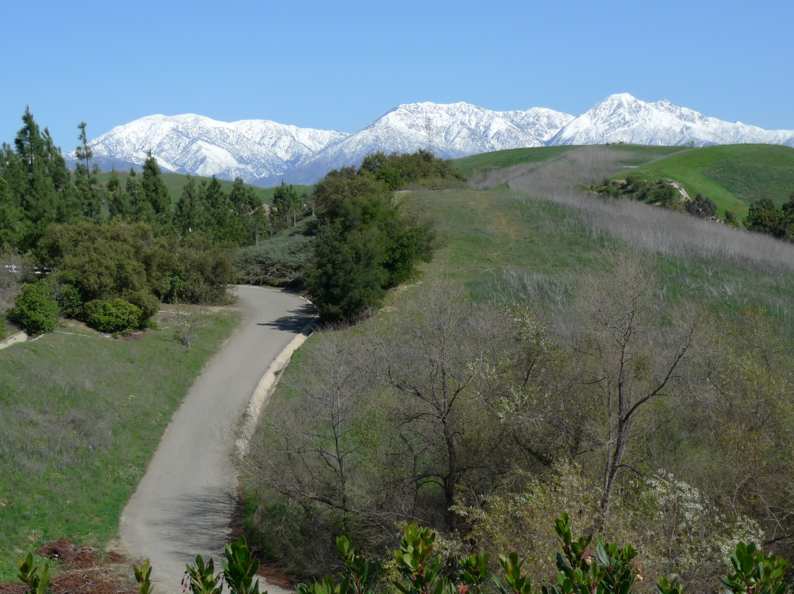
Improve your physical fitness by exploring the City of Golden Grove’s many paths, trails, and parks.

Slide 3
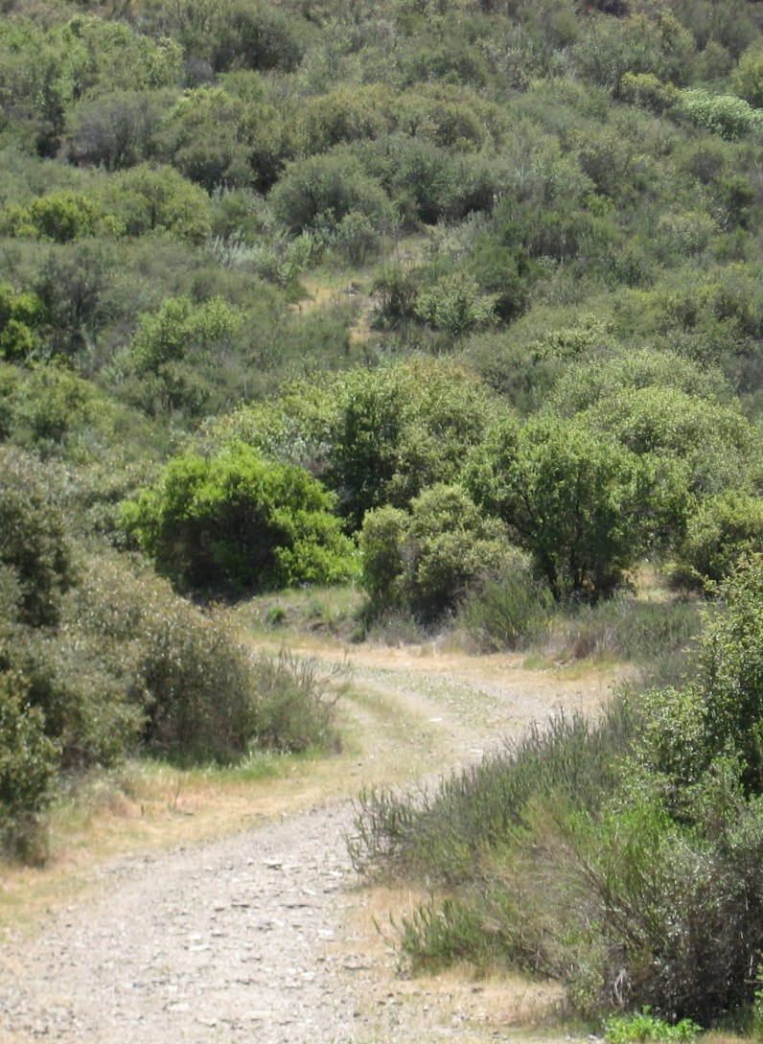
It’s a Great Way To. . .
Improve your cardiovascular fitness
Join a fitness boot camp
Get outside and meet your neighbors
Organize a hiking group

Slide 4
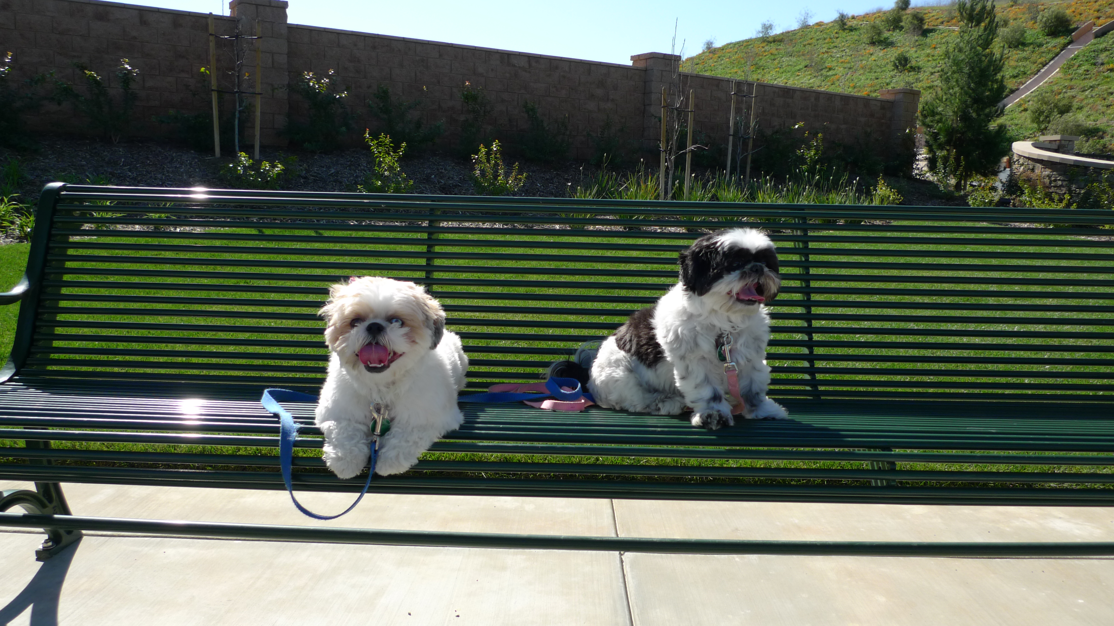
Find a Pet Friendly Trail

Slide 5
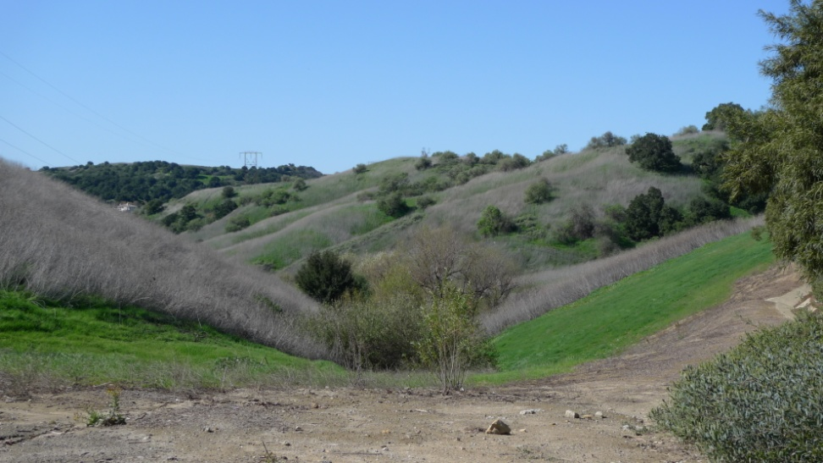
Or Challenge Yourself on a Wildlife Hike
Over 50 miles in the 12, city-maintained trails
Restroom facilities available
Wildlife abounds so be aware of surroundings
Maintained trails can be slippery and hot—be prepared

Slide 6
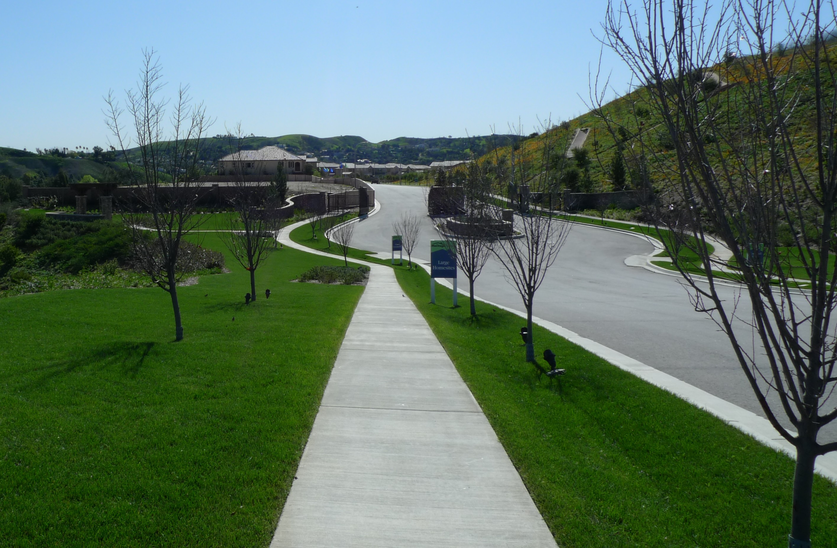
Get Outside! Get Fit! Get Walking!

Slide 7
Set a Pace Based on Your Fitness Level
Easy
Hunters Hill Trail
Moderate
Monte Vista Park
Hidden Trail Park
Crossroads Park
Challenging
Golden Grove State Park
Wilderness Trail

Slide 8
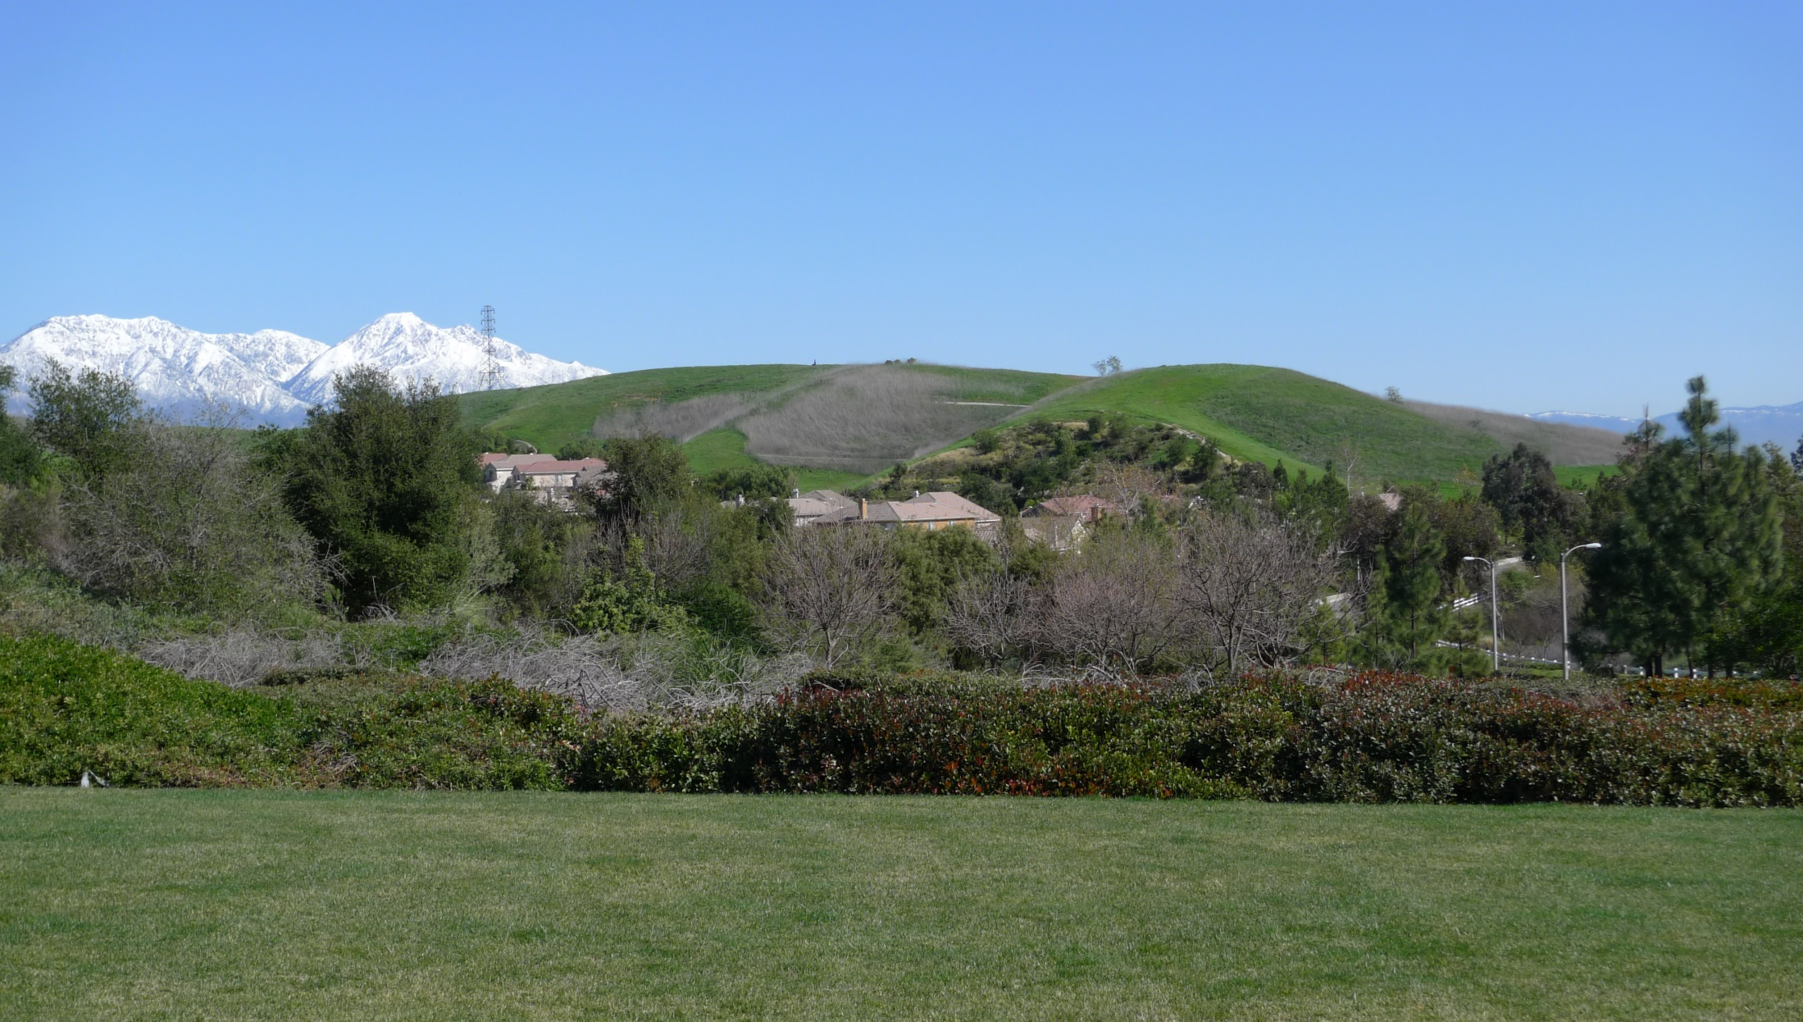
For information on maintained trails, contact Parks and Recreation

